Slide 1
Human Computer Interaction
Evaluations – Cognitive Walkthrough

Slide 2
Why to Evaluate
Some good reasons for investing in user testing:
Problems are fixed before the product is shipped, not after.
The team can concentrate on real problems, not imaginary ones.
Engineers code instead of debating.
Finally, upon first release, your sales department has a rock-solid design it can sell without having to pepper their pitches with how it will all actually work in release 1.1 or 2.0.

Slide 3
What’s it good for?
Question assumptions about what the users will be thinking
Identify controls that may be missing or hard to find
Note inadequate feedback
Suggest difficulties with labels and prompts

Slide 4
Vocabulary Problem
On a piece of paper write the name you would give to a program that tells about interesting activities occurring in some major metropolitan area (e.g., this program would tell you what is interesting to do on Friday or Saturday night). Make the name 10 characters or less

Slide 5
Cognitive Walkthrough Purpose
Focus most clearly on problems that users will have when they first use an interface, without training
Not a technique for evaluating the system over time (e.g., how quickly a user moves from beginner to intermediate)

Slide 6
Cognitive Walkthrough
Formalized way of imagining people's thoughts and actions when they use an interface for the first time.
First select a task that the design is intended to support.
Then try to tell a believable story about each action a user has to take to do the task.

Slide 7
Cognitive Walkthrough
Evaluation method based on the idea that…
  the user learns about the interface in an exploratory way,
  the user has goals,
  the user is applying simple means-ends reasoning.
Evaluation by an expert, who goes through a set task while imitating user performance

Slide 8
Preparation: We need four things
Prior to doing a walkthrough, you need four things:
You need a description of a prototype of the interface. It doesn't have to be complete, but it should be fairly detailed. Things like exactly what words are in a menu can make a big difference.
You need an idea of who the users will be and what kind of experience they'll bring to the job.
You need a task description (for a representative task).
You need a complete, written list of the actions needed to complete the task.

Slide 9
Process of Cognitive Walkthrough
Designer prepares
  Prototype
  User description
  Task description
  Action list
  Along with System description
Designer gives these document to an expert.
The expert reads the descriptions.
The expert carries out the task by following the action list.
The expert asks the following questions with EACH step of the action list:

Slide 10
Cognitive Walkthrough Questions
Will users see that the action is available? (is it visible?)
Once users have found the correct action, will they know it is the one they need? (is it recognizable?)
Is the effect of the action the same as the user’s goal at that point? Will the user try and achieve the right outcome?
After the action is taken, will users understand the feedback they get?

Slide 11
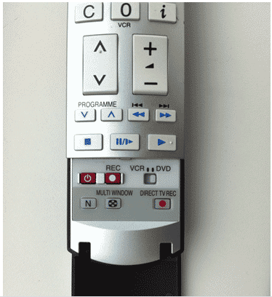
Is it visible?
Notes:
https://www.userfocus.co.uk/articles/cogwalk.html

Slide 12
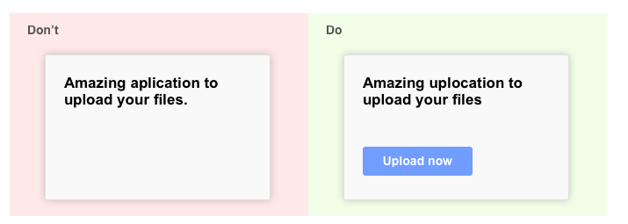

Slide 13
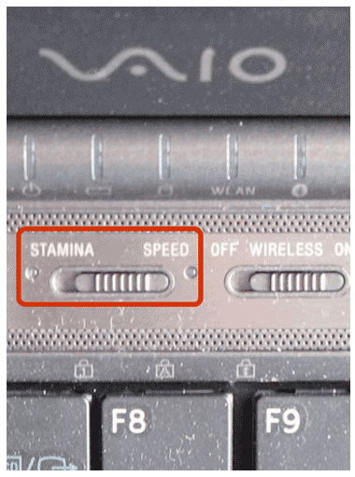
Is it recognizable?

Slide 14
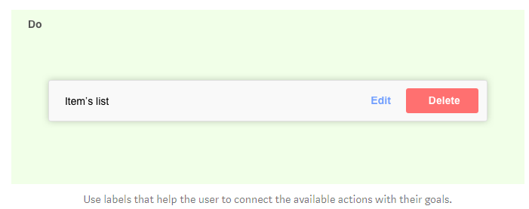

Slide 15
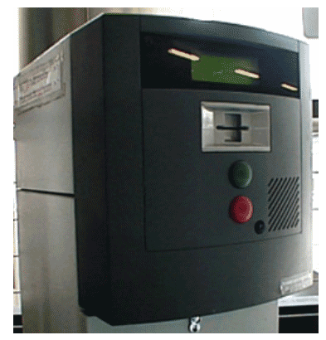
Is the effect of the action the same as the user’s goal at that point?

Slide 16
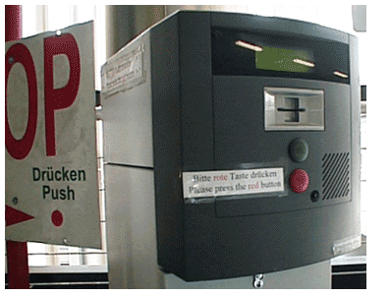

Slide 17
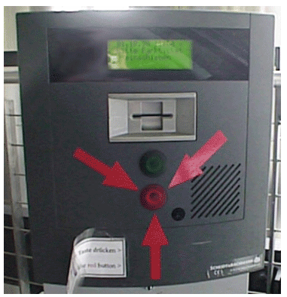

Slide 18
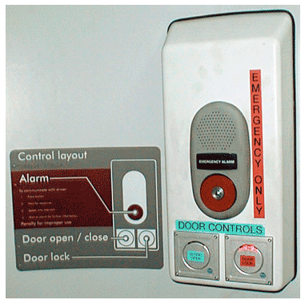
Is feedback understandable?

Slide 19
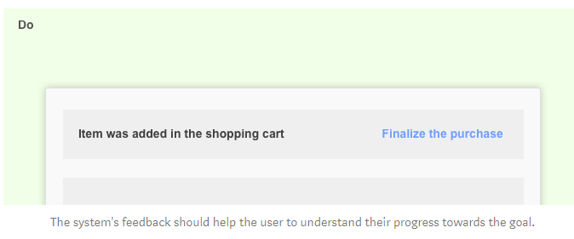

Slide 20
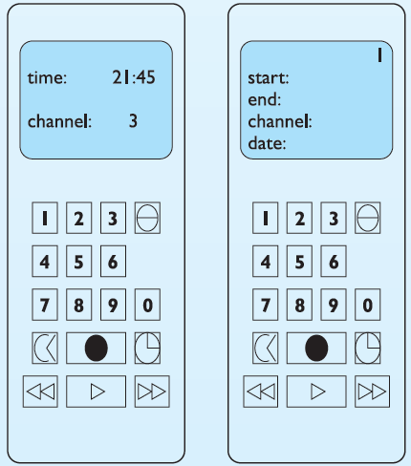
Preparation
Display 2
Display 1
Prototype
  on the right
The users
  We will assume that the user is familiar with VCRs but not with this particular design
Task Description
  Program the video to time-record a program starting at 18.00 and finishing at 19.15 on channel 4 on 24 February 2005.

Slide 21
Preparation: Actions
UA = user action
SD = system display (response)
UA 1: Press the ‘timed record’ button
SD 1: Display moves to timer mode. Flashing cursor appears after ‘start:’
UA 2: Press digits 1 8 0 0
SD 2: Each digit is displayed as typed and flashing cursor moves to next position
UA 3: Press the ‘timed record’ button
SD 3: Flashing cursor moves to ‘end:’
UA 4: Press digits 1 9 1 5
SD 4: Each digit is displayed as typed and flashing cursor moves to next position
UA 5: Press the ‘timed record’ button
SD 5: Flashing cursor moves to ‘channel:’
UA 6: Press digit 4
SD 6: Digit is displayed as typed and flashing cursor moves to next position
UA 7: Press the ‘timed record’ button
SD 7: Flashing cursor moves to ‘date:’
UA 8: Press digits 2 4 0 2 0 5
SD 8: Each digit is displayed as typed and flashing cursor moves to next position
UA 9: Press the ‘timed record’ button
SD 9: Stream number in top right-hand corner of display flashes
UA 10: Press the ‘transmit’ button
SD 10: Details are transmitted to video player and display returns to normal mode
Notes:
UA = user action, SD = system display (response)

Slide 22
Walkthrough UA1
Display 2
Display 1
UA 1: Press the ‘timed record’ button
  Will users see that the action is available?
  Once users have found the correct action, will they know it is the one they need?
  Is the effect of the action the same as the user’s goal at that point?
  After the action is taken, will users understand the feedback they get?
Notes:
https://www.inf.ed.ac.uk/teaching/courses/hci/1718/lects/Lecture08_cognitive_walkthrough.pdf
Will users want to produce whatever effect the action has?
Will users see the control (button, menu, label, etc.) for the action?
Once users find the control, will they recognize that it will produce the effect they want?
After the action is taken, will users understand the feedback they get, so they can confidently continue on to the next action?
https://www2.cs.sfu.ca/CourseCentral/363/inkpen/lecture_notes/363_lecture7.pdf
Are users thinking what the designers assume they will be thinking?
Can users see the control (button, menu, switch, etc.) for the action?
Once users find the control, can they recognize that it produces the effect they want?
After the action is taken, will users understand the feedback they get, so they can go on to the next action with confidence?

Slide 23

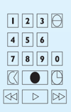
Walkthrough UA1
Question 1: Will users see that the action is available?
The ‘timed record’ button is visible on the remote control.
Question 2: Once users have found the correct action, will they know it is the one they need?
It is not clear which button is the ‘timed record’ button. The icon of a clock (fourth button down on the right) is a possible candidate but this could be interpreted as a button to change the time. Other possible candidates might be the fourth button down on the left or the filled circle (associated with record). In fact, the icon of the clock is the correct choice but it is quite possible that the user would fail at this point. This identifies a potential usability problem.
Question 3: Is the effect of the action the same as the user’s goal at that point?
The timed record button initiates timer programming. It is reasonable to assume that a user familiar with VCRs would be trying to do this as his first goal.
Question 4: After the action is taken, will users understand the feedback they get?
Once the action is taken the display changes to the timed record mode and shows familiar headings (start, end, channel, date). It is reasonable to assume that the user would recognize these as indicating successful completion of the first action.

Slide 24
Cognitive Walkthrough Example
Consider the following interface for a train ticket vending machine
1. Choose destination or enter fare
Newark
Rahway
Metropark
Metuchen
Edison
New Brunswick
2. Indicate journey type
One-way
Round-trip
3. Deposit money
coins
bills
LIFT for ticket and change
4. Press to receive ticket and change

Slide 25
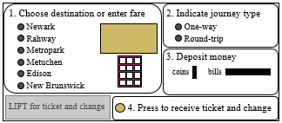
Cognitive Walkthrough Example
Scenario:
  Nick is visiting a friend for
  a few days and wants to
  buy a one-way ticket
  to New Brunswick
  Nick has a $5 bill in his
  pocket plus some loose change.
What does the user want to achieve?
Purchase a one-way ticket to New Brunswick

Slide 26
Cognitive Walkthrough Example
1. Will the correct action be evident to the user?
1. Choose destination or enter fare
Newark
Rahway
Metropark
Metuchen
Edison
New Brunswick
2. Indicate journey type
One-way
Round-trip
3. Deposit money
coins
bills
LIFT for ticket and change
4. Press to receive ticket and change

Slide 27
Cognitive Walkthrough Example
1. Will the correct action be evident to the user? (subgoals provided to user)
1. Choose destination or enter fare
Newark
Rahway
Metropark
Metuchen
Edison
New Brunswick
2. Indicate journey type
One-way
Round-trip
Yes
3. Deposit money
coins
bills
LIFT for ticket and change
4. Press to receive ticket and change

Slide 28
Cognitive Walkthrough Example
2. Will the user connect the correct action’s description/label with his/her intent?
1. Choose destination or enter fare
Newark
Rahway
Metropark
Metuchen
Edison
New Brunswick
2. Indicate journey type
One-way
Round-trip
3. Deposit money
coins
bills
LIFT for ticket and change
4. Press to receive ticket and change

Slide 29
Cognitive Walkthrough Example
2. Will the user connect the correct action’s description/label with his/her intent?
1. Choose destination or enter fare
Newark
Rahway
Metropark
Metuchen
Edison
New Brunswick
2. Indicate journey type
One-way
Round-trip
Yes
3. Deposit money
coins
bills
LIFT for ticket and change
4. Press to receive ticket and change

Slide 30

Cognitive Walkthrough Example
3. Will the user properly interpret the system’s response? (know if chose right/wrong?)
1. Choose destination or enter fare
Newark
Rahway
Metropark
Metuchen
Edison
New Brunswick
2. Indicate journey type
One-way
Round-trip
3. Deposit money
coins
bills
LIFT for ticket and change
4. Press to receive ticket and change

Slide 31
Cognitive Walkthrough Example
3. Will the user properly interpret the system’s response? (know if chose right/wrong?)
1. Choose destination or enter fare
Newark
Rahway
Metropark
Metuchen
Edison
New Brunswick
2. Indicate journey type
One-way
Round-trip
Yes (if button lights up…)
3. Deposit money
coins
bills
LIFT for ticket and change
4. Press to receive ticket and change

Slide 32
Cognitive Walkthrough Example
1. Will the correct action be evident to the user?
1. Choose destination or enter fare
Newark
Rahway
Metropark
Metuchen
Edison
New Brunswick
2. Indicate journey type
One-way
Round-trip
3. Deposit money
coins
bills
LIFT for ticket and change
4. Press to receive ticket and change

Slide 33
Cognitive Walkthrough Example
1. Will the correct action be evident to the user?
Yes
1. Choose destination or enter fare
Newark
Rahway
Metropark
Metuchen
Edison
New Brunswick
2. Indicate journey type
One-way
Round-trip
3. Deposit money
coins
bills
LIFT for ticket and change
4. Press to receive ticket and change

Slide 34
Cognitive Walkthrough Example
2. Will the user connect the correct action’s description/label with his/her intent?
1. Choose destination or enter fare
Newark
Rahway
Metropark
Metuchen
Edison
New Brunswick
2. Indicate journey type
One-way
Round-trip
3. Deposit money
coins
bills
LIFT for ticket and change
4. Press to receive ticket and change

Slide 35
Cognitive Walkthrough Example
2. Will the user connect the correct action’s description/label with his/her intent?
1. Choose destination or enter fare
Newark
Rahway
Metropark
Metuchen
Edison
New Brunswick
2. Indicate journey type
One-way
Round-trip
Yes
3. Deposit money
coins
bills
LIFT for ticket and change
4. Press to receive ticket and change

Slide 36
Cognitive Walkthrough Example
3. Will the user properly interpret the system’s response? (know if chose right/wrong?)
1. Choose destination or enter fare
Newark
Rahway
Metropark
Metuchen
Edison
New Brunswick
2. Indicate journey type
One-way
Round-trip
3. Deposit money
coins
bills
LIFT for ticket and change
4. Press to receive ticket and change

Slide 37
Cognitive Walkthrough Example
2. Will the user properly interpret the system’s response? (know if chose right/wrong?)
1. Choose destination or enter fare
Newark
Rahway
Metropark
Metuchen
Edison
New Brunswick
2. Indicate journey type
One-way
Round-trip
Yes …
One-way
$6.35
3. Deposit money
coins
bills
LIFT for ticket and change
4. Press to receive ticket and change

Slide 38
Cognitive Walkthrough Example
1. Will the correct action be evident to the user?
1. Choose destination or enter fare
Newark
Rahway
Metropark
Metuchen
Edison
New Brunswick
2. Indicate journey type
One-way
Round-trip
One-way
$6.35
3. Deposit money
coins
bills
LIFT for ticket and change
4. Press to receive ticket and change

Slide 39
Cognitive Walkthrough Example
1. Will the correct action be evident to the user?
Yes
1. Choose destination or enter fare
Newark
Rahway
Metropark
Metuchen
Edison
New Brunswick
2. Indicate journey type
One-way
Round-trip
One-way
$6.35
3. Deposit money
coins
bills
LIFT for ticket and change
4. Press to receive ticket and change

Slide 40
Cognitive Walkthrough Example
2. Will the user connect the correct action’s description/label with his/her intent?
1. Choose destination or enter fare
Newark
Rahway
Metropark
Metuchen
Edison
New Brunswick
2. Indicate journey type
One-way
Round-trip
One-way
$6.35
3. Deposit money
coins
bills
LIFT for ticket and change
4. Press to receive ticket and change

Slide 41
Cognitive Walkthrough Example
2. Will the user connect the correct action’s description/label with his/her intent?
1. Choose destination or enter fare
Newark
Rahway
Metropark
Metuchen
Edison
New Brunswick
2. Indicate journey type
One-way
Round-trip
One-way
$6.35
3. Deposit money
Yes
coins
bills
LIFT for ticket and change
4. Press to receive ticket and change

Slide 42
Cognitive Walkthrough Example
3. Will the user properly interpret the system’s response? (know if chose right/wrong?)
1. Choose destination or enter fare
Newark
Rahway
Metropark
Metuchen
Edison
New Brunswick
2. Indicate journey type
One-way
Round-trip
One-way
$6.35
3. Deposit money
coins
bills
$5
LIFT for ticket and change
4. Press to receive ticket and change

Slide 43
Cognitive Walkthrough Example
3. Will the user properly interpret the system’s response? (know if chose right/wrong?)
1. Choose destination or enter fare
Newark
Rahway
Metropark
Metuchen
Edison
New Brunswick
2. Indicate journey type
One-way
Round-trip
One-way
$6.35
3. Deposit money
coins
bills
LIFT for ticket and change
4. Press to receive ticket and change

Slide 44
Cognitive Walkthrough Example
3. Will the user properly interpret the system’s response? (know if chose right/wrong?)
1. Choose destination or enter fare
Newark
Rahway
Metropark
Metuchen
Edison
New Brunswick
2. Indicate journey type
One-way
Round-trip
One-way
$6.35
Recv’d: $5.00
3. Deposit money
coins
bills
LIFT for ticket and change
4. Press to receive ticket and change
→ Add received amount display

Slide 45
Cognitive Walkthrough Example
Finish with a normal case first (e.g. completion of purchase)
Also be sure to handle common error cases
Examples:
  What if Nick realized he didn’t have enough money before putting it in?
  What if Nick realizes he doesn’t have enough only after putting in money?

Slide 46
Cognitive Walkthrough Example
Not enough $…
What does the user want to achieve?
1. Choose destination or enter fare
Newark
Rahway
Metropark
Metuchen
Edison
New Brunswick
2. Indicate journey type
One-way
Round-trip
One-way
$6.35
Recv’d: $5.00
3. Deposit money
coins
bills
LIFT for ticket and change
4. Press to receive ticket and change

Slide 47
Cognitive Walkthrough Example
Not enough $…
What does the user want to achieve?
Cancel and get money back
1. Choose destination or enter fare
Newark
Rahway
Metropark
Metuchen
Edison
New Brunswick
2. Indicate journey type
One-way
Round-trip
One-way
$6.35
Recv’d: $5.00
3. Deposit money
coins
bills
LIFT for ticket and change
4. Press to receive ticket and change

Slide 48
Cognitive Walkthrough Example
Not enough $…
1. Will the correct action be evident?
1. Choose destination or enter fare
Newark
Rahway
Metropark
Metuchen
Edison
New Brunswick
2. Indicate journey type
One-way
Round-trip
One-way
$6.35
Recv’d: $5.00
3. Deposit money
coins
bills
LIFT for ticket and change
4. Press to receive ticket and change

Slide 49
Cognitive Walkthrough Example
Not enough $…
1. Will the correct action be evident?
Probably not!
1. Choose destination or enter fare
Newark
Rahway
Metropark
Metuchen
Edison
New Brunswick
2. Indicate journey type
One-way
Round-trip
One-way
$6.35
Recv’d: $5.00
3. Deposit money
coins
bills
?
?
?
LIFT for ticket and change
4. Press to receive ticket and change

Slide 50
Cognitive Walkthrough Example
Not enough $…
1. Will the correct action be evident?
Probably not!
→ Add a new UI element to make it clear!
1. Choose destination or enter fare
Newark
Rahway
Metropark
Metuchen
Edison
New Brunswick
2. Indicate journey type
One-way
Round-trip
One-way
$6.35
Recv’d: $5.00
3. Deposit money
coins
bills
Cancel & return money
LIFT for ticket and change
4. Press to receive ticket and change

